Slide 1
Logistic Classification
Classification Using Logistic Regression

Slide 2
Logistic classification
In binary logistic classification, the target variable has two possible values, typically represented as 1 and 0, or "yes" and "no." The goal is to estimate the probability that an instance belongs to the positive class based on its input features.
The logistic regression model assumes a linear relationship between the input features and the log-odds of the positive class. It applies the logistic function (also called the sigmoid function) to the linear combination of the input features and model coefficients to convert it into a probability between 0 and 1.
Notes:
Logarithms convert multiplicative relationships into additive ones
Logarithms convert multiplicative relationships into additive ones, making it easier to work with and optimize the objective function.
log(ab) = log(a) + log(b)

Slide 3
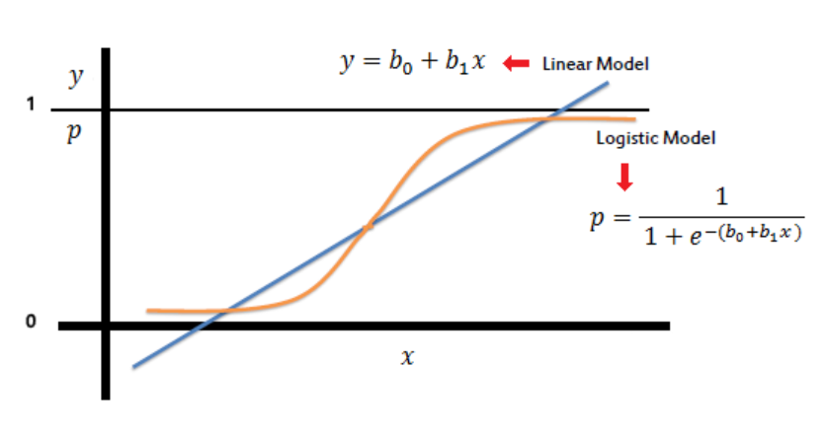
Logistic classification

Slide 4
Logistic classification
Mathematically, the logistic function is defined as:
p = 1 / (1 + exp(-z)),
where p represents the probability of the positive class, and z is the linear combination of the input features and model coefficients:
z = β₀ + β₁x₁ + β₂x₂ + ... + βₚxₚ,
where β₀, β₁, β₂, ..., βₚ are the model coefficients (weights), and x₁, x₂, ..., xₚ are the input features.
Notes:
logit(p) = log(p / (1 - p))

Slide 5
Logistic classification
During the training process, the logistic regression model estimates the optimal values for the coefficients by maximizing the log likelihood of the observed data:
Maximize J(β₀, β₁) = [∑(y * log(p) + (1 - y) * log(1 - p))]
OR minimizing the negative log-likelihood loss function:
Minimize J(β₀, β₁) = - [∑(y * log(p) + (1 - y) * log(1 - p))]
This is typically solved using optimization algorithms like gradient descent.
Once the model is trained, it can be used to make predictions on new instances by calculating the probability of the positive class using the learned coefficients and the logistic function. A threshold (e.g., 0.5) is often used to convert the predicted probabilities into binary class labels.

Slide 6
Logistic classification – Training steps
Initialize the model parameters β₀ and β₁ to some initial values.
Calculate the linear combination of the input features and the parameters for each training example.
Apply the sigmoid function to the linear combination to obtain the predicted probabilities p.
Compute the negative log-likelihood loss J(β₀, β₁) using the formula: -[∑(y * log(p) + (1 - y) * log(1 - p))].
Compute the gradient of the loss function with respect to the parameters β₀ and β₁.
Update the parameters using an optimization algorithm such as gradient descent
Repeat steps 2-6 until convergence or for a fixed number of iterations.

Slide 7
Is it possible to apply linear regression and then use the sigmoid function, p = 1 / (1 + exp(-z)), to obtain probabilities for classification?

Slide 8
Yes, Here's how you can do it:
Apply Linear Regression: First, perform linear regression on your dataset. Linear regression aims to find the best-fit line that minimizes the squared error between the predicted values and the actual values. The linear regression model will give you a continuous output.
Apply Sigmoid Function: Once you have the output from the linear regression model, you can apply the sigmoid function to obtain probabilities for classification. The sigmoid function takes any real-valued number as input and maps it to a value between 0 and 1. In logistic regression, this value represents the probability of belonging to the positive class.
p = 1 / (1 + exp(-z)),
where p is the predicted probability, and z is the output from the linear regression model.
3. Set a Threshold: To convert the predicted probabilities into class labels, you can set a threshold value. For example, if the predicted probability is greater than or equal to 0.5, you can assign it to the positive class, and if it is less than 0.5, you can assign it to the negative class.
If p >= 0.5, class = 1 (Positive class) If p < 0.5, class = 0 (Negative class)

Slide 9
Muli-class classification

Slide 10
Can we apply the sigmoid function for multi-class classification?

Slide 11
Muli-class classification
The sigmoid function is primarily used for binary classification, where there are only two classes (e.g., positive and negative). However, it can be adapted for multi-class classification using different strategies, such as one-vs-all (one-vs-rest) or one-vs-one approaches.

Slide 12
one-vs-all approach
1. One-vs-All (One-vs-Rest) Strategy: In this approach, you train multiple binary logistic regression models, each considering one class as the positive class and the rest as the negative class. During inference, you apply each model to the input, and the class with the highest sigmoid output is assigned.
For example, if you have three classes (A, B, and C), you would train three separate logistic regression models:
Model 1: Class A vs. not Class A (B or C)
Model 2: Class B vs. not Class B (A or C)
Model 3: Class C vs. not Class C (A or B)
During inference, you would apply each model to the input, and the class with the highest sigmoid output (probability) is chosen as the final predicted class.

Slide 13
one-vs-all approach example
Let's consider an example of the one-vs-all (one-vs-rest) approach for multi-class classification using the sigmoid function. Assume we have three classes: Class A, Class B, and Class C.
In the one-vs-all strategy, we train multiple binary logistic regression models, each considering one class as the positive class and the rest as the negative class.
1. Model 1: Class A vs. not Class A (B or C)
2. Model 2: Class B vs. not Class B (A or C)
3. Model 3: Class C vs. not Class C (A or B)
Assume we have trained these models, and during inference, we want to classify a new input example.

Slide 14
one-vs-all approach example
Let's say we obtain the following sigmoid outputs from each model for the input example:
Model 1 (Class A vs. not Class A): sigmoid_output_1 = 0.9
Model 2 (Class B vs. not Class B): sigmoid_output_2 = 0.3
Model 3 (Class C vs. not Class C): sigmoid_output_3 = 0.7
To determine the final predicted class using the one-vs-all strategy, we choose the class with the highest sigmoid output. In this case, Class A has the highest sigmoid output (0.9) from Model 1. Therefore, we assign the input example to Class A as the final predicted class.
The one-vs-all approach allows us to use the sigmoid function for multi-class classification by training multiple binary logistic regression models and selecting the class with the highest sigmoid output as the predicted class.

Slide 15
one-vs-one approach
One-vs-One Strategy: In this approach, you train a binary logistic regression model for every pair of classes. For example, if you have three classes (A, B, and C), you would train three models: A vs. B, A vs. C, and B vs. C.
During inference, you apply each pair-wise model to the input, and the class that wins the most binary classification competitions is assigned as the final predicted class.

Slide 16
one-vs-one approach- example
In the one-vs-one strategy, we create binary logistic regression models for each pair of classes. In this case, we would create three models:
Model 1: Class A vs. Class B
Model 2: Class A vs. Class C
Model 3: Class B vs. Class C
Assume we have trained these models, and during inference, we want to classify a new input example.

Slide 17
one-vs-one approach example
Let's say we obtain the following sigmoid outputs from each model for the input example:
Model 1 (Class A vs. Class B): sigmoid_output_1 = 0.8 A
Model 2 (Class A vs. Class C): sigmoid_output_2 = 0.6 A
Model 3 (Class B vs. Class C): sigmoid_output_3 = 0.4 B
To determine the final predicted class using the one-vs-one strategy, we count the number of times each class wins in the binary classification competitions. In this case, we have:
Class A wins twice (Model 1 and Model 2)
Class B wins once (Model 3)
Class C does not win any binary competition
Since Class A wins the most competitions, we assign the final predicted class as Class A because it received the most votes.
Notes:
Accuracy = (Number of correct predictions) / (Total number of predictions)

